Slide 1


Slide 1
Apache Kafka
What is it? How do we use it in our project at Swisscom?
Notes:
Who is a developer or devops?
Who is a kafka specialist?
My first talk

Slide 2
Introduction
Adam Zurada adam.zurada1@swisscom.com or adamzurada@gmail.com
GitHub: presentation & example code for Kafka: https://github.com/zurada/kafka-talk
Notes:
Swisscom employee
This is my email you can contact me, or gmail if I was fired

Slide 3
Not a specialist!
Notes:
8 months
The First project with Kafka
Share the story, very nice adventure so far
A developer view more then DevOps. I am a java guy
My personal perpective on the project

Slide 4
1. Our use case 2. Why Kafka? 3. Kafka Basics 4. Kafka in action 5. Challenges 6. Deployment
Notes:
Agenta points

Slide 5
1. Our use case
Bank application:
Manage Users
Manage Transactions
Have all history of system for auditing
Additionally: monitoring tools and statistics

Slide 6
REST API
Transactions
Users
Notes:
But the system was about to grow rapidly with different modules

Slide 7

With CQRS (Command Query Responsibility Segregation)
separate models: different object models, probably running in different logical processes, perhaps on separate hardware.
Let's create a user!
Give me list of users!
UI
REST
REST
Commands
Queries
DB

Slide 8
REST connection
Commands
Transaction Component
User Component
Queries
Notes:
One of approaches

Slide 9
Event system
Queries
Commands
Transaction Component
User Component
Notes:
With events?

Slide 10
Event system
Queries
Commands
Transaction Component
User Component
Order Engine
Security of Orders
Notification Component
Notes:
We knew as well it is going to be growing

Slide 11
Where is source of truth?
Manage its lifecycle and migrations
Event system
Queries
Commands
Transaction Component
User Component
Order Engine
Security of Orders
Notification Component
DB
DB
DB
DB
DB
Notes:
The next thing to consider – DB approach. Where to save?

Slide 12
Event system
Queries
Commands
Transaction Component
User Component
Order Engine
Security of Orders
Notification Component
DB
Notes:
One database for everybody? It would lead us to EventSourcing possibility

Slide 13
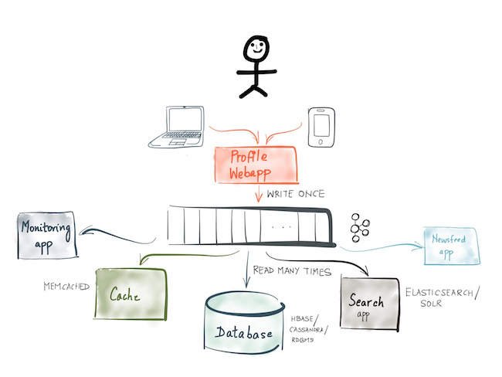
With Event Sourcing ?
Notes:
Multiple subsribers

Slide 14
Event system
Queries
Commands
Transaction Component
User Component
Order Engine
Security of Orders
Notification Component
DB

Slide 15
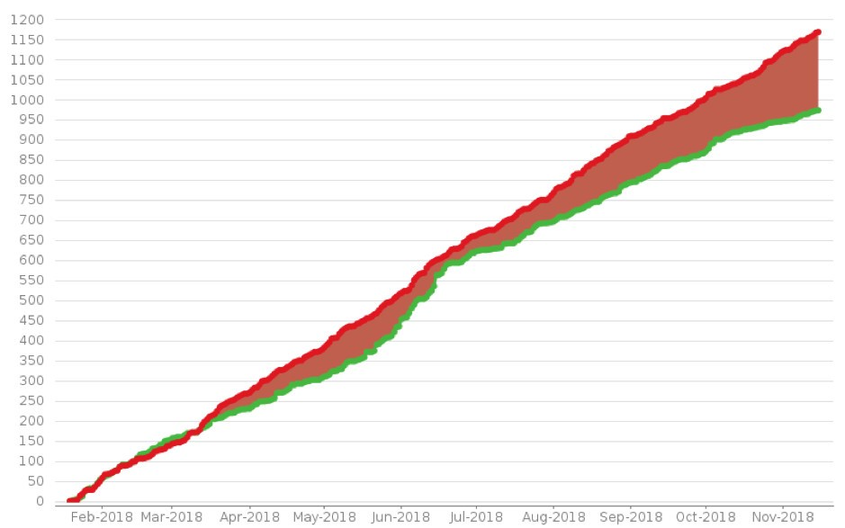
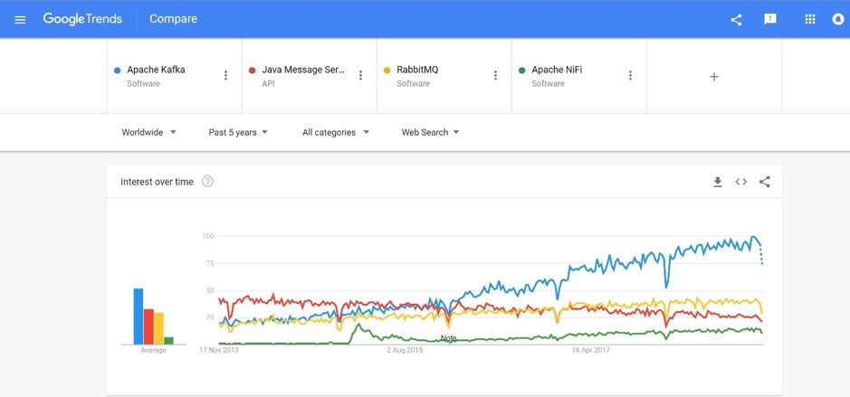
2. Why Kafka?

Slide 16
RABBIT MQ?
IBM MQ?
TIBCO?
ACTIVE MQ?
APACHE CAMEL?
APACHE KAFKA?
SPARK?
OTHERS?

Slide 17
RABBIT MQ vs KAFKA?

Slide 18
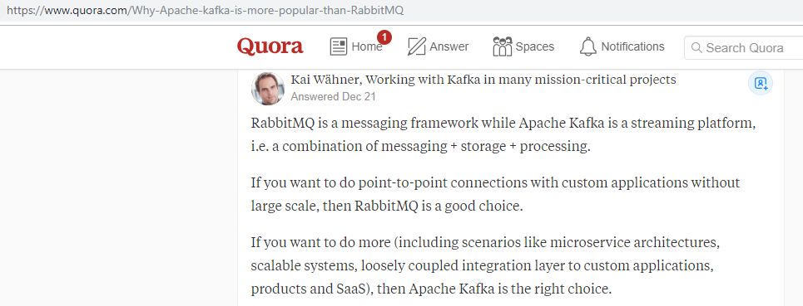

Slide 19
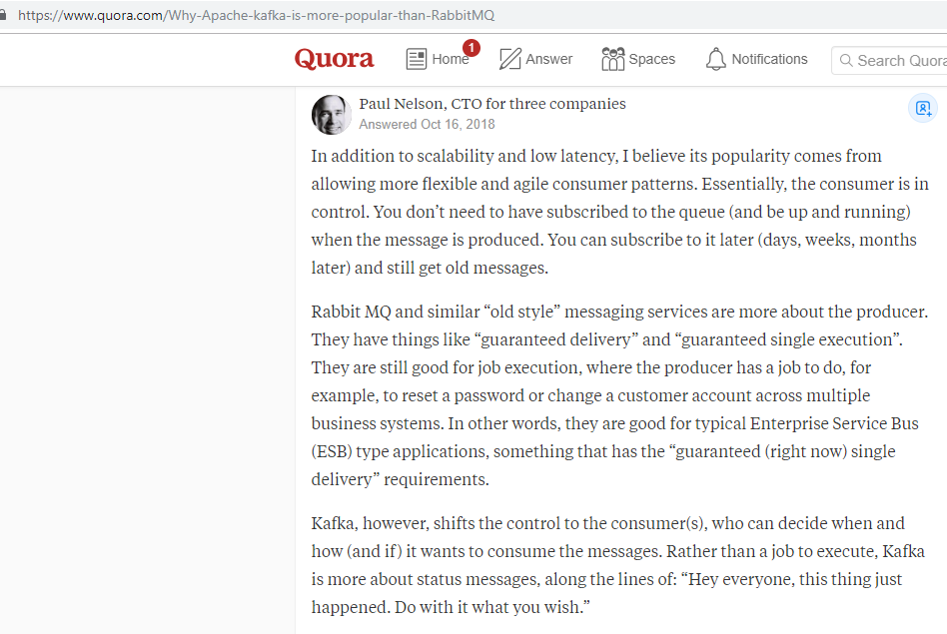
Notes:
Read the first part

Slide 20
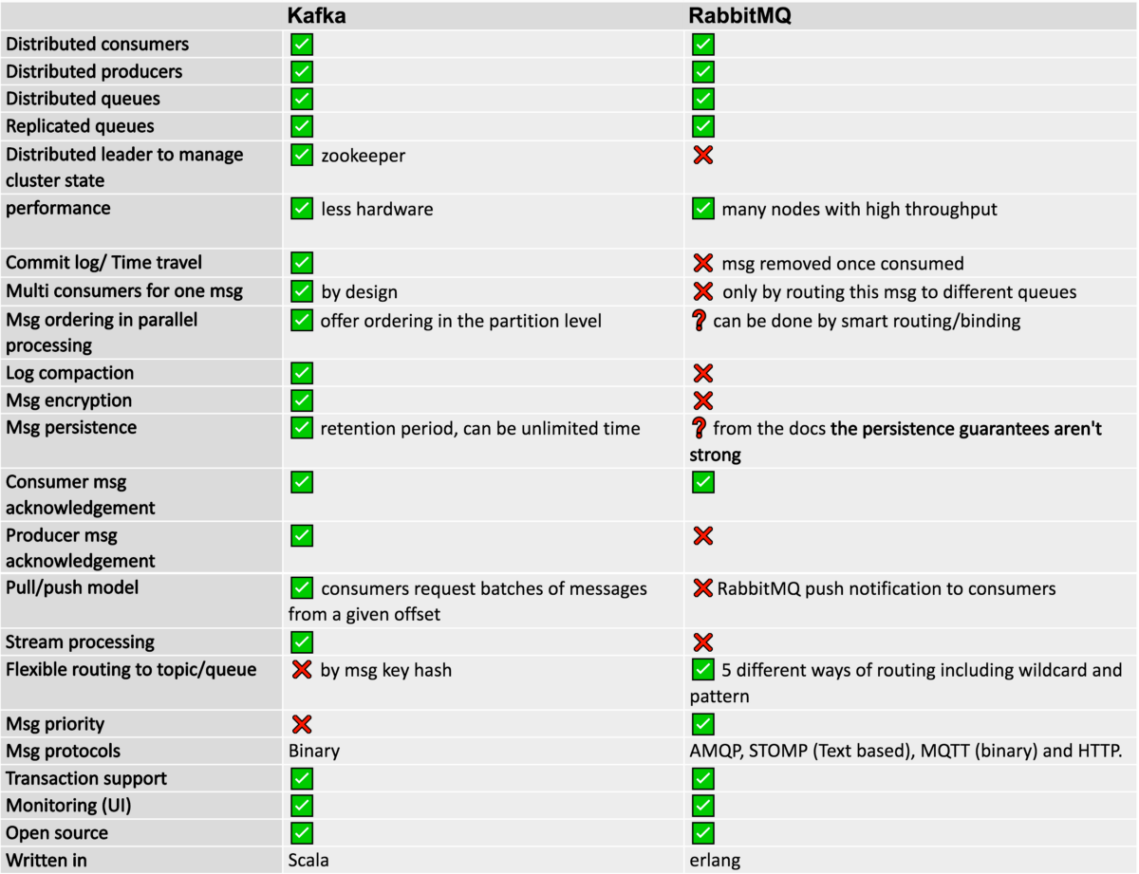
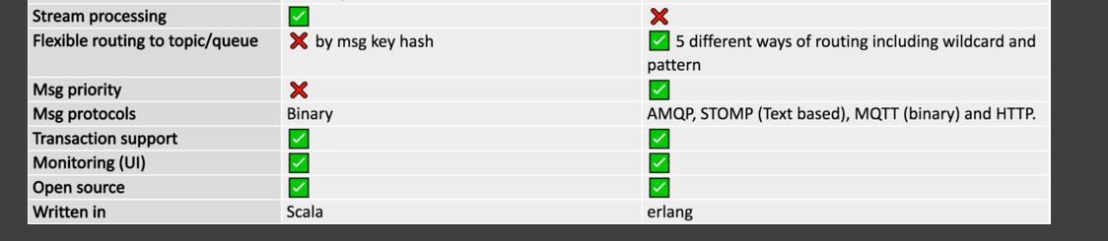

Notes:
Distributed: both good. kafka by design thanks to topic partitions. In RabbitMQ competitive consumers (the first wins)
High Availability: both good. Step further by kafka to introduce Zookeeper to manage state of the cluster.
Performancesequential disk I/O, less hardwarehigh throughput: several millions of messages / s with tiny count of nodes.
RabbitMQ 1 million msg / sec -> 30+ nodes.
In Kafka multi subsribers -> event sourcing In RabbitMQ message can be consumed only once, and when consumed, the message disappears and isn’t accessible anymore.

Slide 21
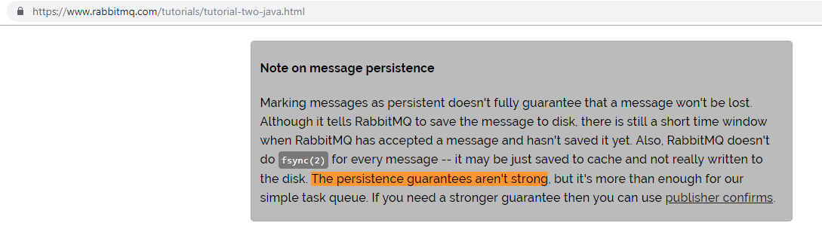

Slide 22
Use Kafka if you need
Time travel/durable/commit log Many consumers for the same message High throughput Stream processing Replicability High availability Message order
And EventSourcing!
Use RabbitMq if you need
Flexible routing Priority Queue A standard protocol message queue
https://itnext.io/kafka-vs-rabbitmq-f5abc02e3912

Slide 23
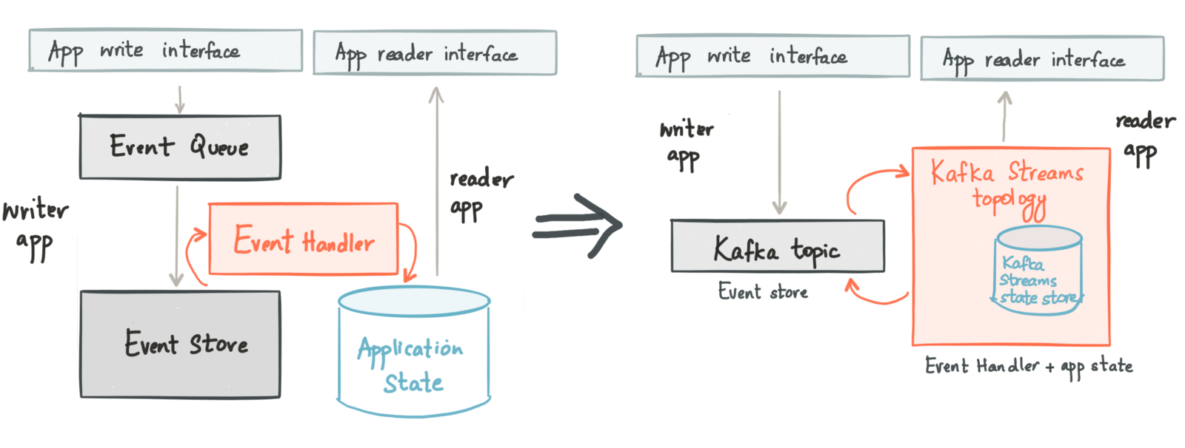
With CQRS and Event Sourcing

Slide 24
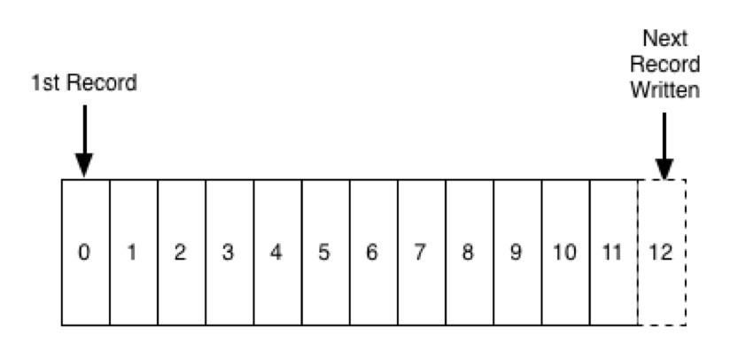
3. Kafka Basics
COMMIT LOG

Slide 25
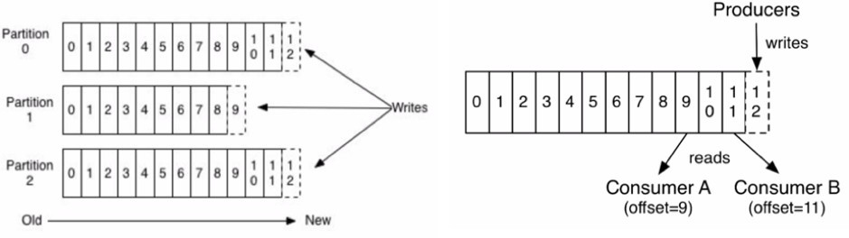
Partitions
CONSUMERS, PRODUCERS, OFFSET, ORDER OF MSGS

Slide 26
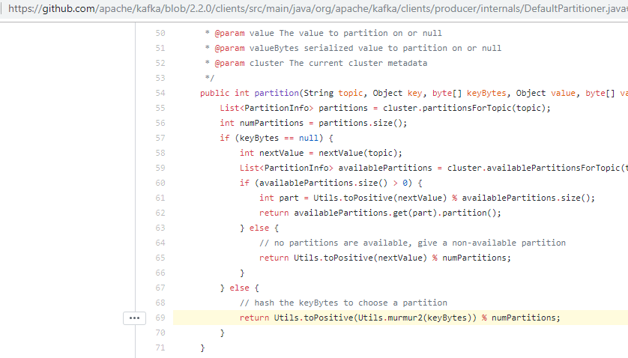

Slide 27
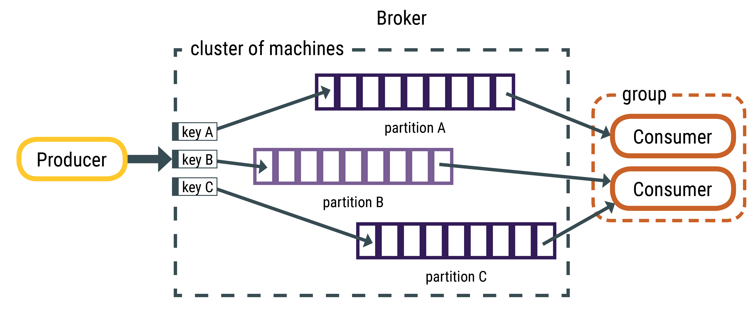
KEY vs random partition
TOPIC T1
SENDING NULL KEYS?

Slide 28
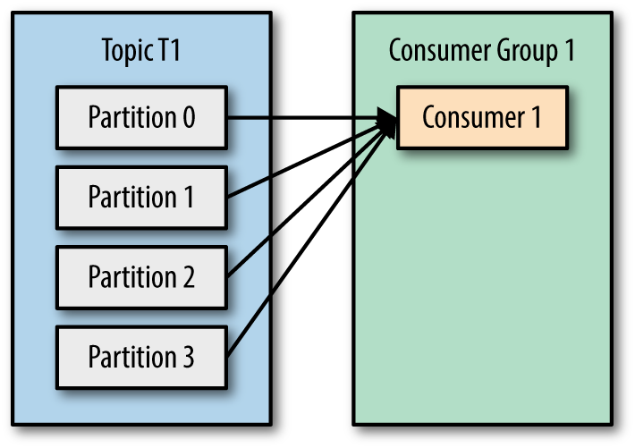
Consumer group

Slide 29
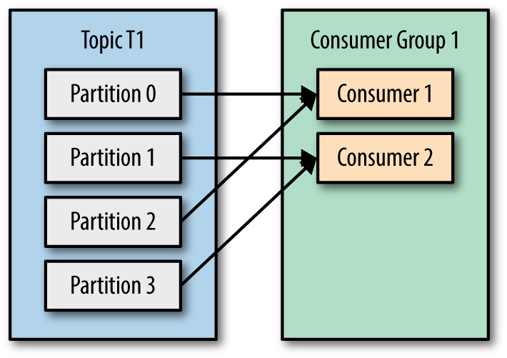

Slide 30
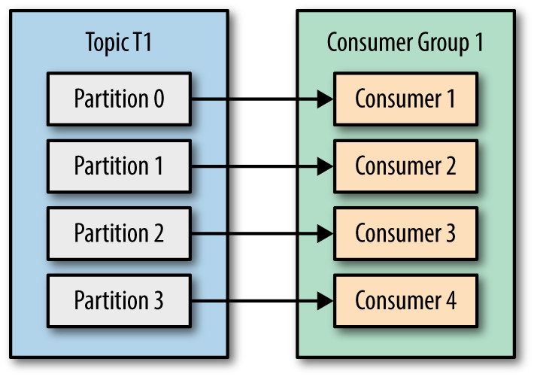

Slide 31
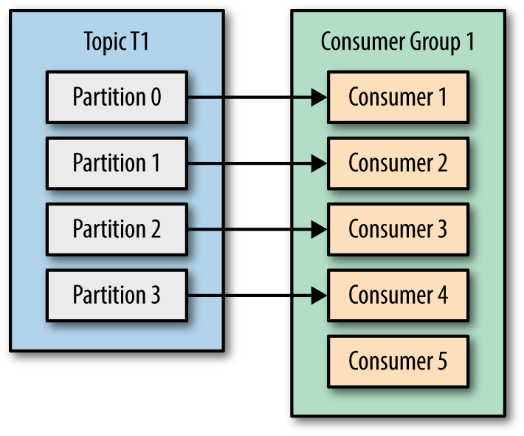

Slide 32
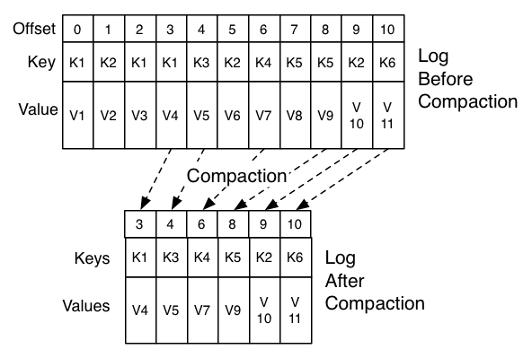
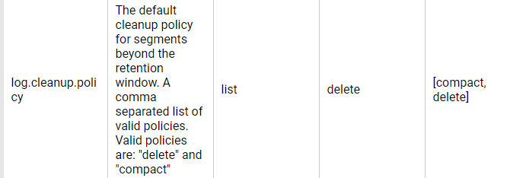
TOPIC COMPACTION

Slide 33
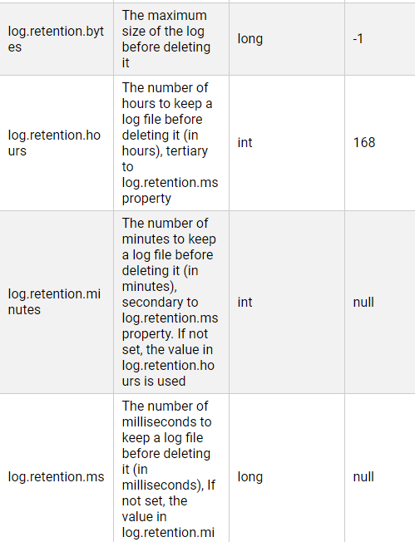

TOPIC RETENTION
SET TO -1 TO HAVE IT FOR EVER
BROKER lvl vs TOPIC lvl?

Slide 34
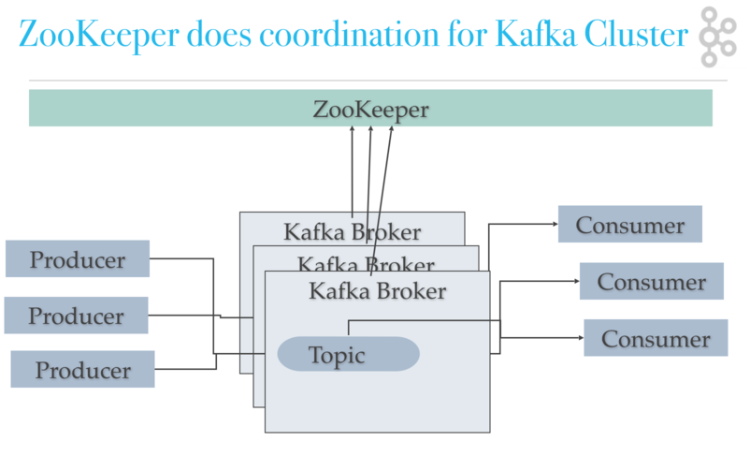
ZOOKEEPER?

Slide 35
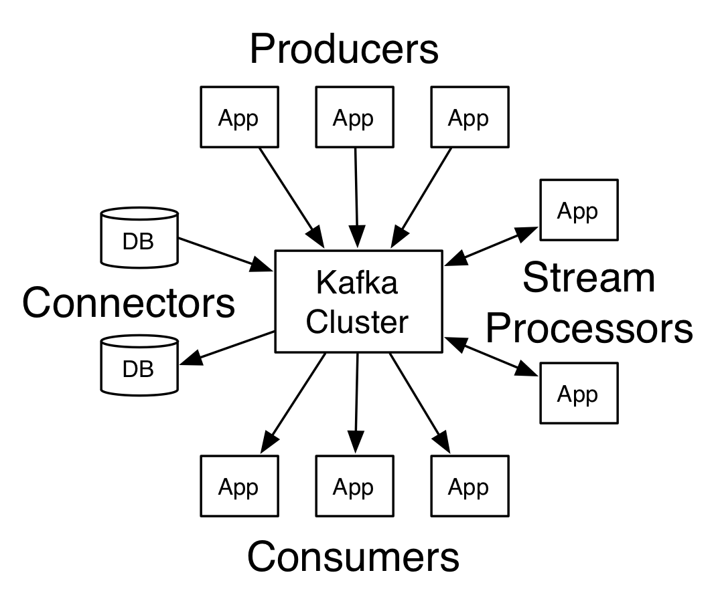
Kafka World

Slide 36

Kafka World

Slide 37
4. Kafka in Action
Kafka with Docker
Kafka Streams basics
Kafka Streams tests
Notes:
Show why kafka1 is not enough
Run locally the "default configuration" and try to explain
Remove serialization ex handler, Show serialization exception
Change consumer to contain the String as value and produce message with some example strings
Show filter, map (reverse string),
Change to json – explain jsonSerde why needed custom https://kafka.apache.org/10/documentation/streams/developer-guide/datatypes.html#json
Show multiple partitions

Slide 38
Kafka with Docker
https://github.com/simplesteph/kafka-stack-docker-compose/blob/master/zk-single-kafka-single.yml

Slide 39
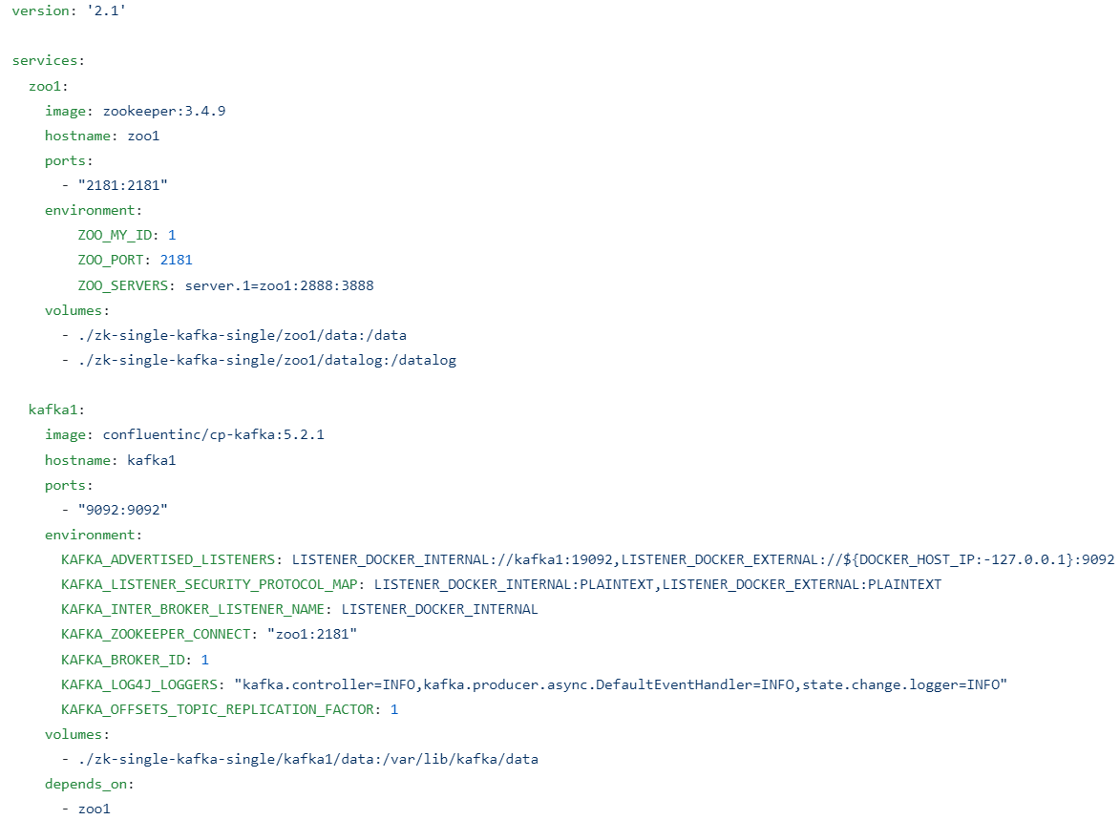

Slide 40
Kafka Streams
Configuration with Spring
Peek
Producer?
Test Driver?
Map
Filter
Branch
Group By
Select Key
To vs Through
Reduce -> Table
Next silde: stream vs table

Slide 41
Aggregations
Reduce
Aggregate
Join
Transformers
Processors

Slide 42
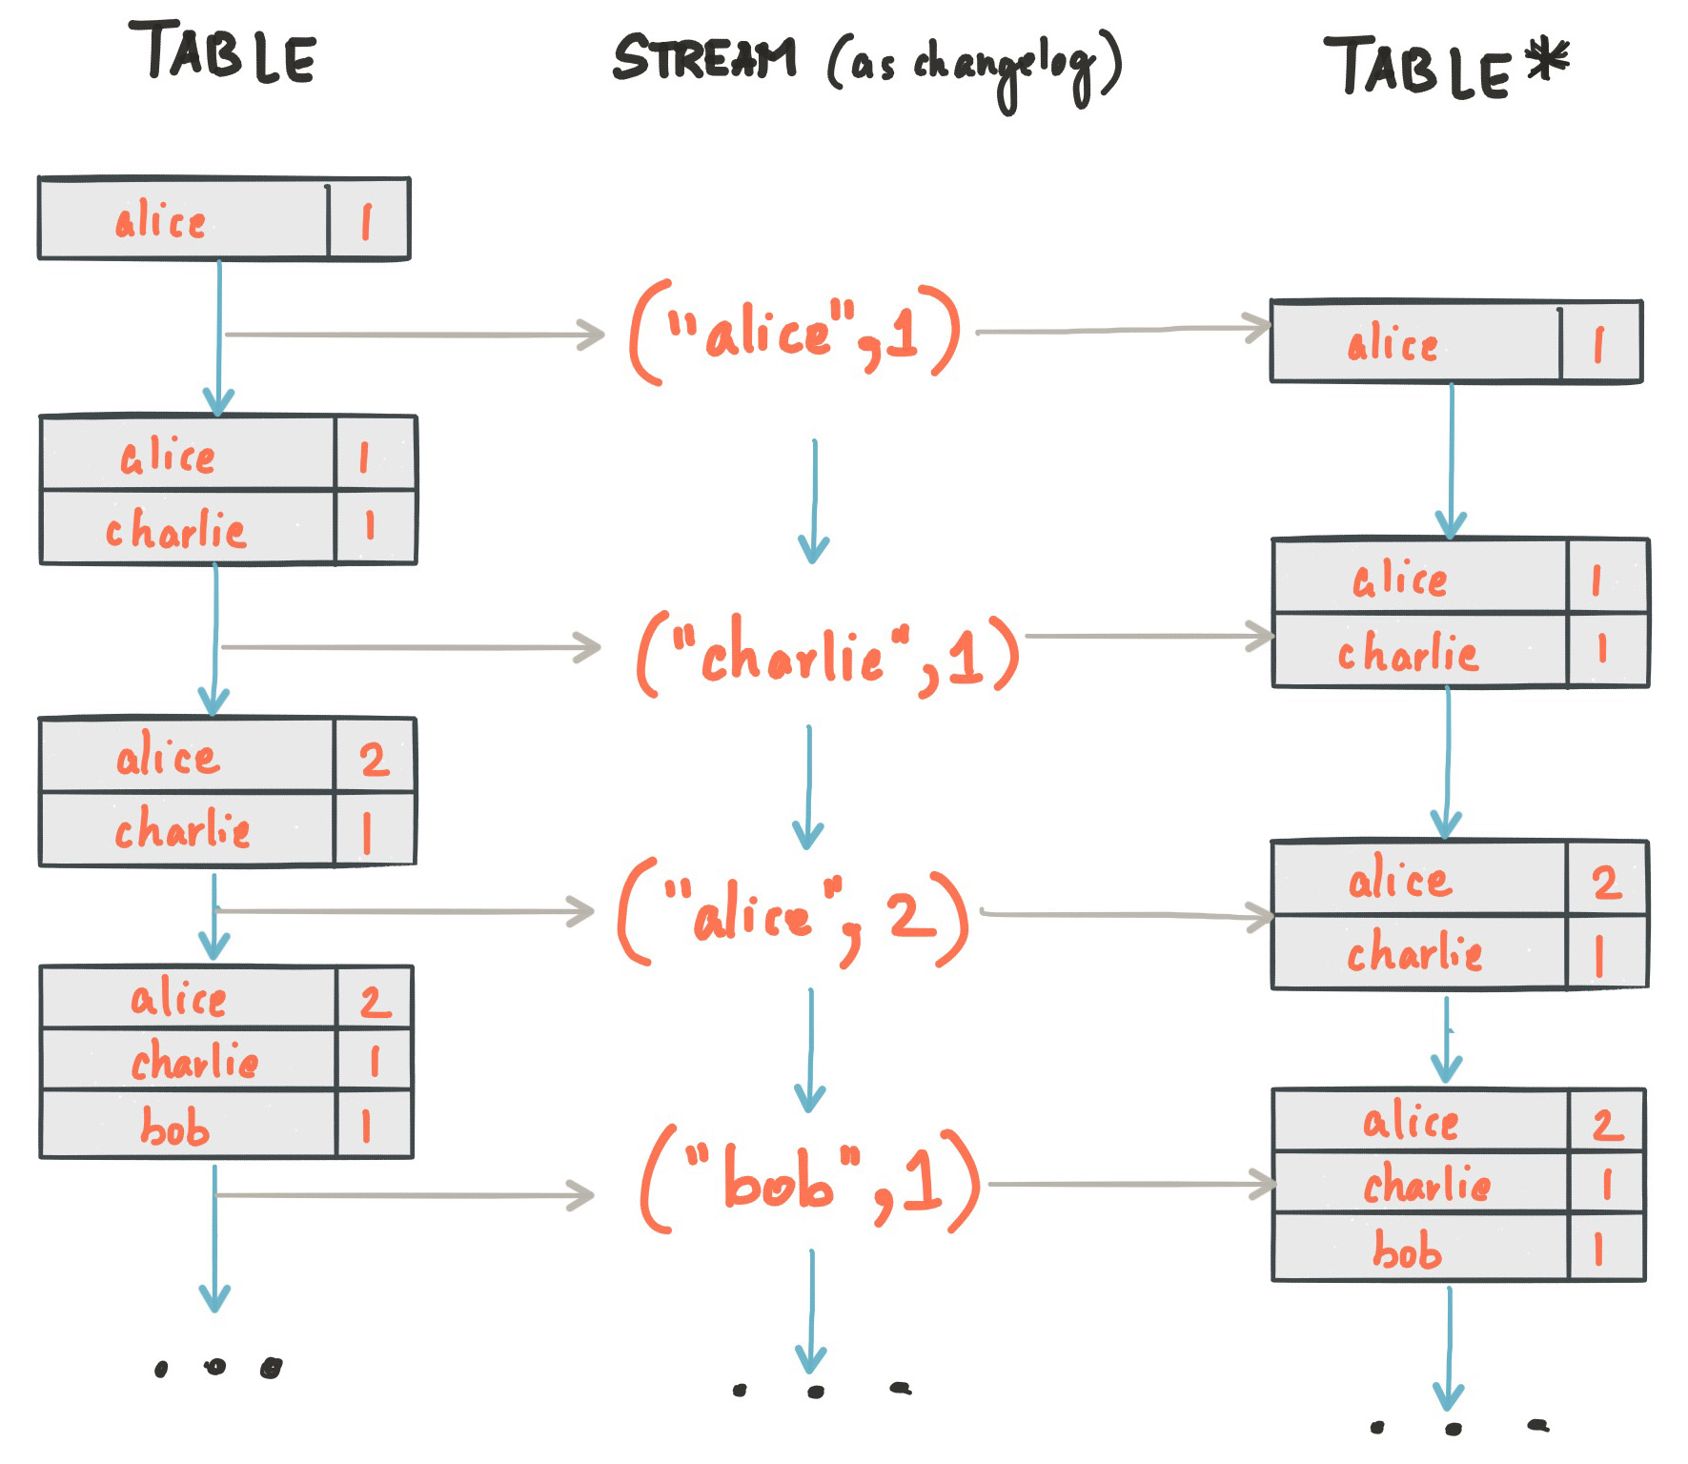

Slide 43
Table vs GlobalTable
Notes:
Show code .groupBYKey .reduce – particular partitions
Show code GlobalTable, change to dummy,run

Slide 44
RocksDB centered.
Kafka
Queries
Commands
Transaction Component
User Component
Order Engine
Security of Orders
Notification Component
KV
DB
Notes:
Main characteristics:
Between
Fitler with JPA and Predicates with QueryDSL
Cache in memory with RocksDB
.all
.range
.get(key)
SHOW CODE OF GLOBAL TABLE

Slide 45
Repartition
When? Select key + aggregation
Different count of partitions?

Slide 46
5. Challenges

Slide 47
Aggregations
Challenge: MISTAKE: result as list
Challenge: MISTAKE: join with global tables – polling

Slide 48
How to query?
Problem of .all() for filtering
Key range idea – next slide
Kafka Connect
Direct wrap of Kafka Streams with JPA

Slide 49
So what is key? Relationship solution
organisationUUID, then get one row userUUID or iterate ☹
Problem of lists? Problem of iteration?
vs
Compound key:
organisationUUID:userUUid:positionUuid
TASK:
Give me all users for organization! How is it with both approaches?

Slide 50
Start stop loops
- What kind of exceptions?
- Dead letter queues?

Slide 51
How to do transactions?
Transactions for Kafka: rollback
Direct producers
External calls as last step

Slide 52
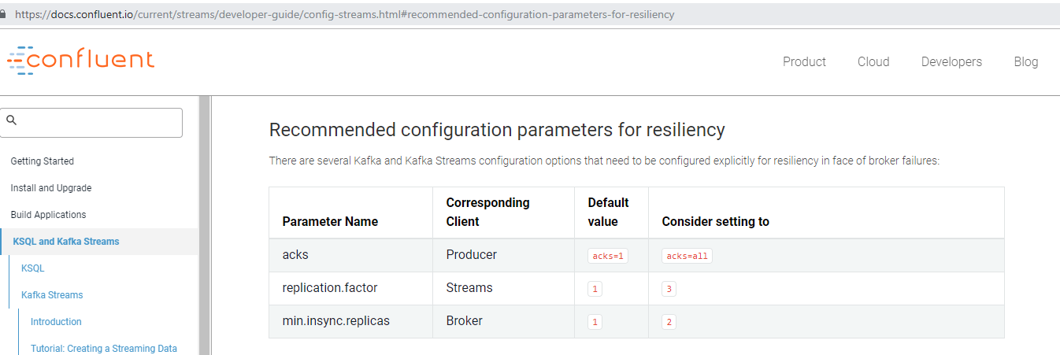
6. Deployment
+ topic autocreation

Slide 53
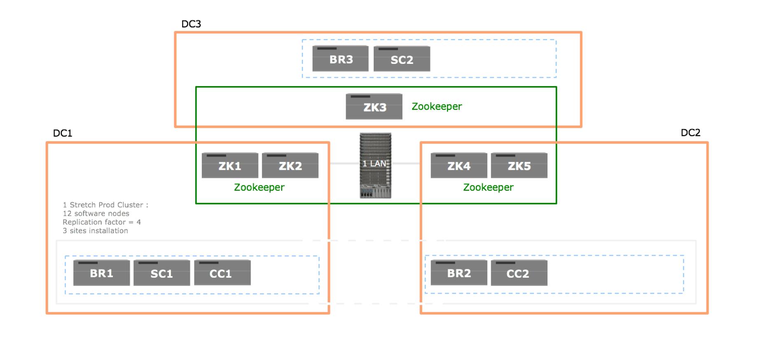
Notes:
No Docker, plain VMs and plain Kafka in RedHat as rpm
Three brokers, stretched - replication factor four, three minimum in sync replicas.
Different Scenarios considering
• Two Schema Registries - in separate DC’s
• Optionally a logical Connect cluster for installing data sink and source Connectors - two Connect workers, each in
separate DC’s
• Control Center (C3) running in one (or two DC’s for HA)

Slide 54
Our approach
Event system
Queries
Commands
Transaction Component
User Component
Order Engine
Security of Orders
Notification Component
DB

Slide 55
Our approach: ORDER + STATE MACHINE
FLOW: CREATE USER
Cmds api
Security of orders
INITIAL
VALIDATED
SAVED
User Cmpnt
Notifications Cmpnt
FAILED? ROLLBACK? MODEL + AVRO?
DONE

Slide 56
Thanks!
Adam Zurada adam.zurada1@swisscom.com or adamzurada@gmail.com
GitHub: presentation & example code for Kafka: https://github.com/zurada/kafka-talk
Notes:
Swisscom employee
This is my email you can contact me, or gmail if I was fired

